Slide 1
Parts Crib Database Project
Presentation by: Mohand Ferawana

Slide 2
Project Proposal
Parts Crib Database Project is a project trying to achieve a quick and efficient way of renting items from the parts crib. The goal is to keep track of tools and equipment as well as students holding them back after rental.
The project can use three different effectors:
USB barcode scanner
Magnetic Stripe Card Swipe Reader
Barcode reader/scanner with CCD camera

Slide 3
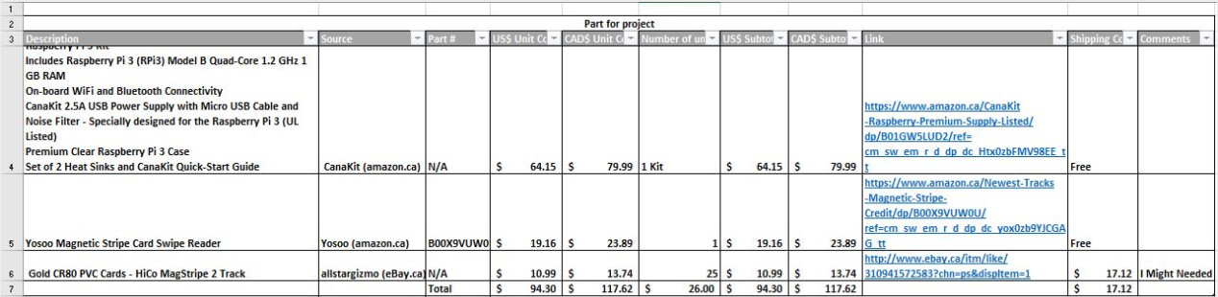
Project Budget

Slide 4
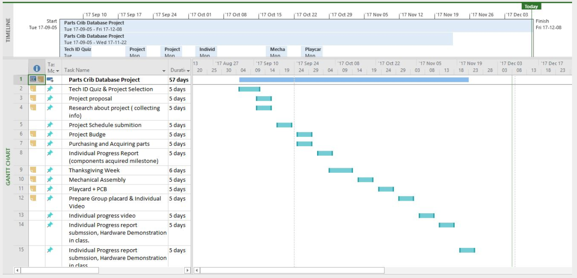
Project Schedule

Slide 5

Build Video

Slide 6
Course Knowledge
TECH 101 -Electric Circuits
TECH 104 -Programming Fundamentals
TECH 150 -Electronic Devices and Circuits
CENG 251 -UNIX Internals
CENG 320 -Network Programming

Slide 7
Questions Time ????
Thank You !!!!

